Slide 1
Operating System Security Semester Project
Project Title:
Exploiting permissions in Linux OS (Kali Linux)
Group Members:
Faizan-Ur-Rehman - 190852
Hammad Anjum - 190797
Ahtsham Saeed - 190817
Muhammad Aryan Ali - 190813

Slide 2
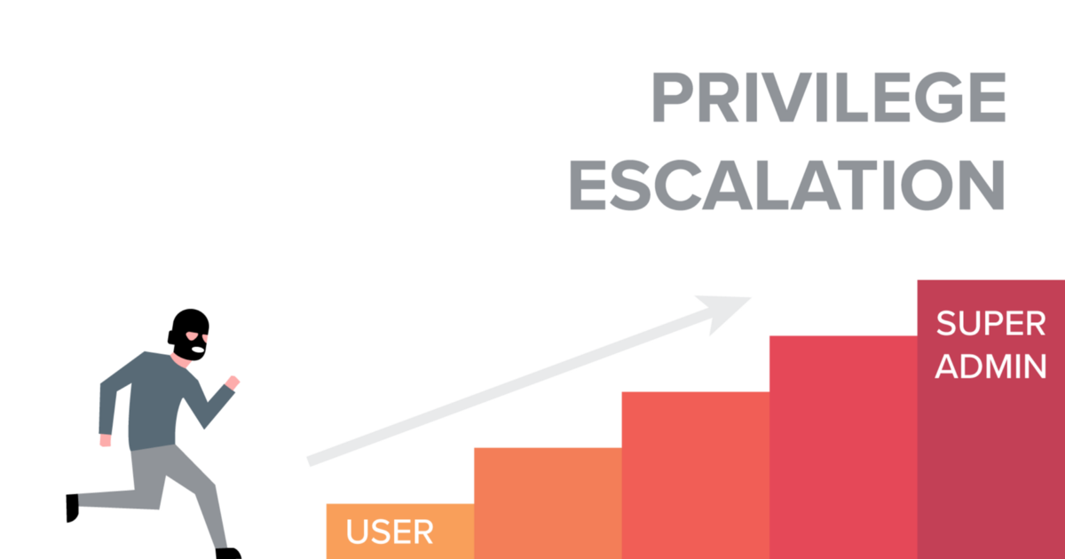
What is Privilege Escalation?
Privilege escalation is the act of exploiting a bug, a design flaw, or a configuration oversight in an operating system or software application to gain elevated access to resources that are normally protected from an application or user

Slide 3
Our Work:-
We will demonstrate the concept of privilege escalation on a vulnerable kali Linux machine.

Slide 4
Users on the machine
Hammad
Kali
Root

Slide 5

Working (Attack Snippet)

Slide 6
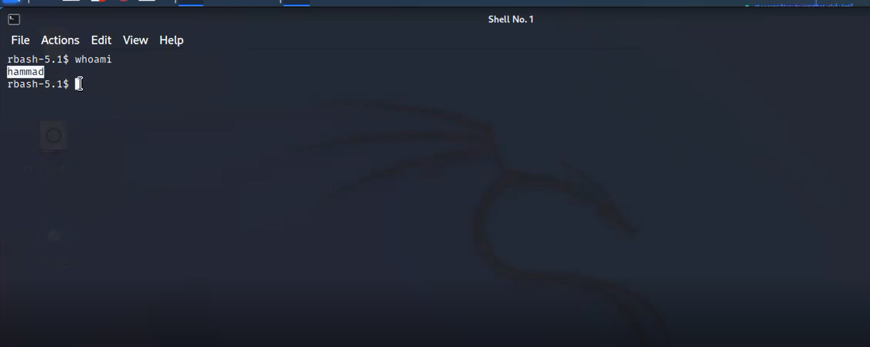
Current user is Hammad

Slide 7
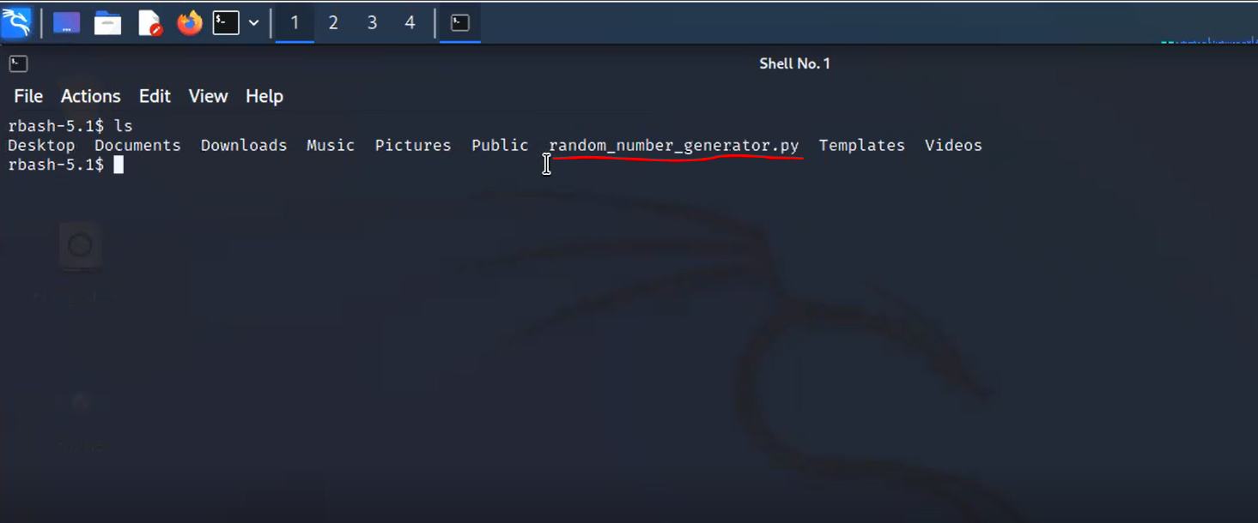
Seeing files for vulnerability

Slide 8
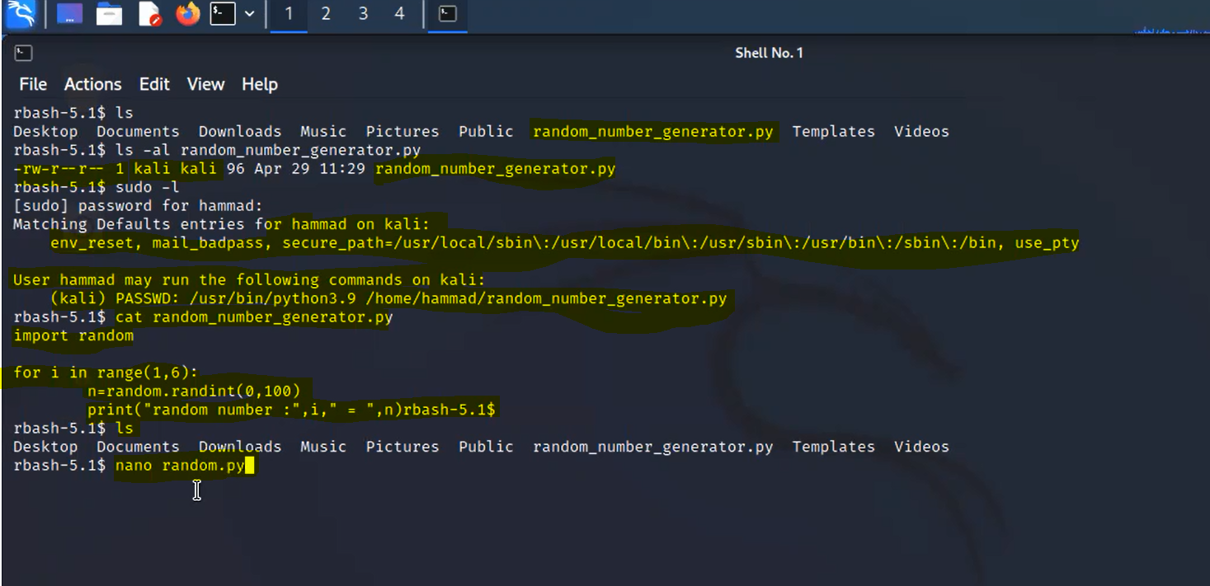
This is the file permissions

Slide 9
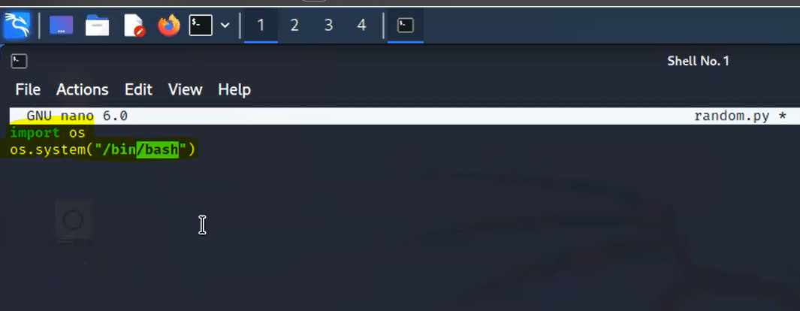
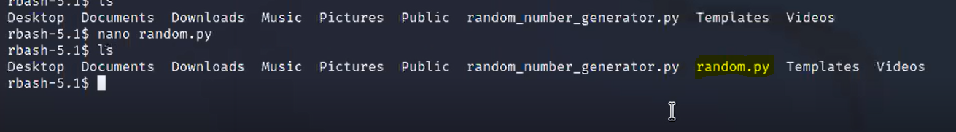
Creating our file named as “random.py”

Slide 10
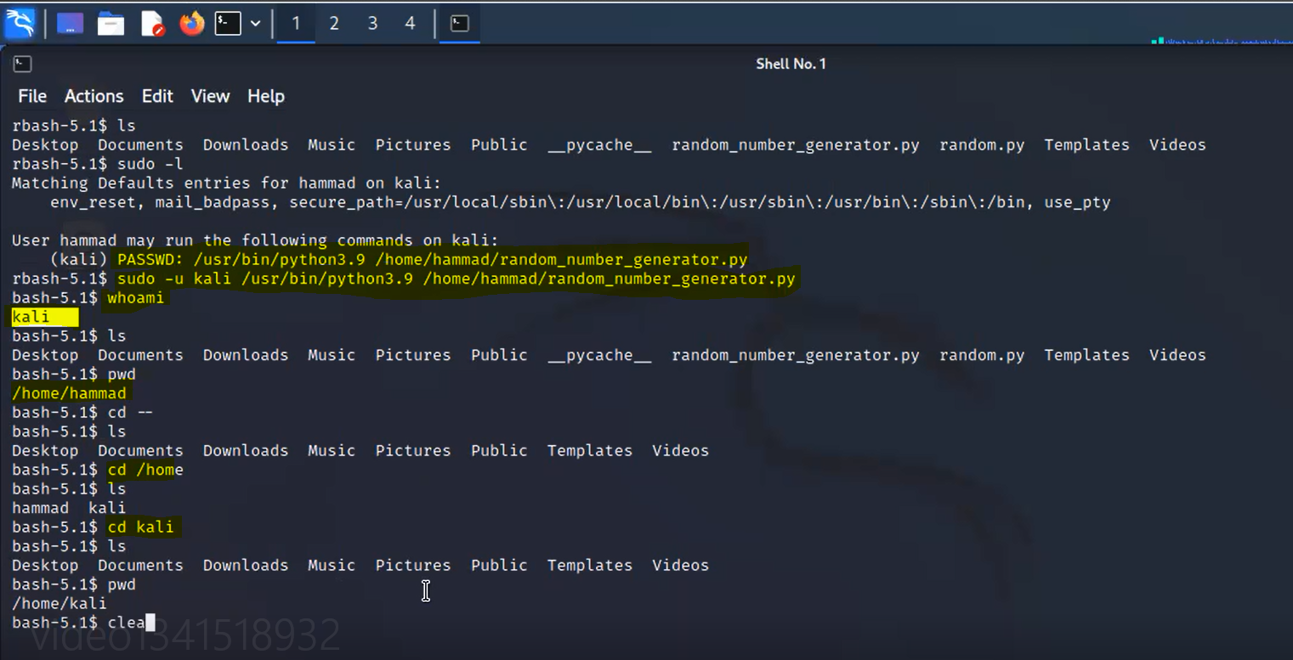
Escalating from hammad to kali using our file

Slide 11
done
Hammad
Kali
Root

Slide 12
SUID permission
Vulnerability for escalating from kali to root
Said permission is called SUID, which stands for Set owner User ID. This is a special permission that applies to scripts or applications. If the SUID bit is set, when the command is run, it's effective UID becomes that of the owner of the file, instead of the user running it.

Slide 13
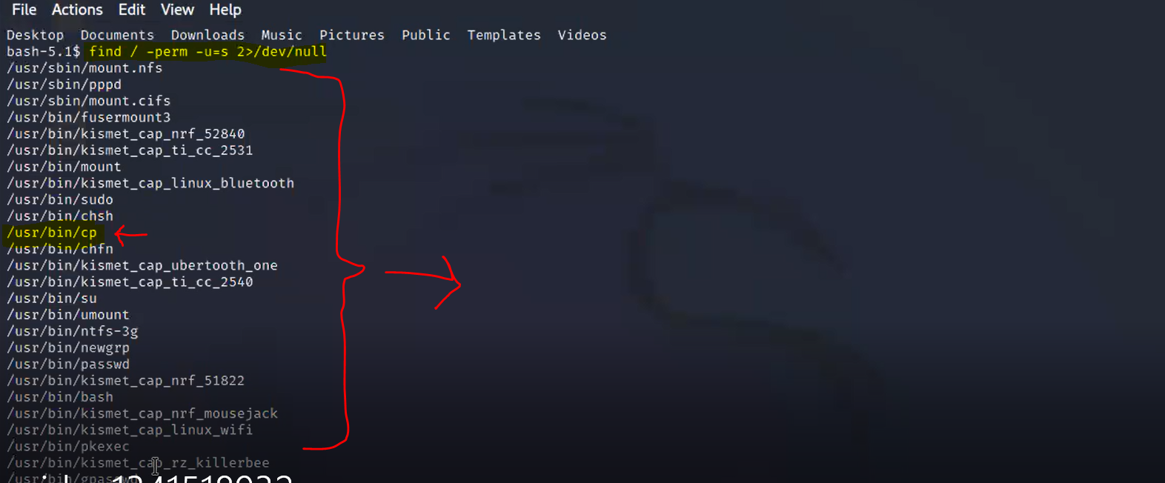
Finding vulnerability
Target command
Files with suid permissions

Slide 14
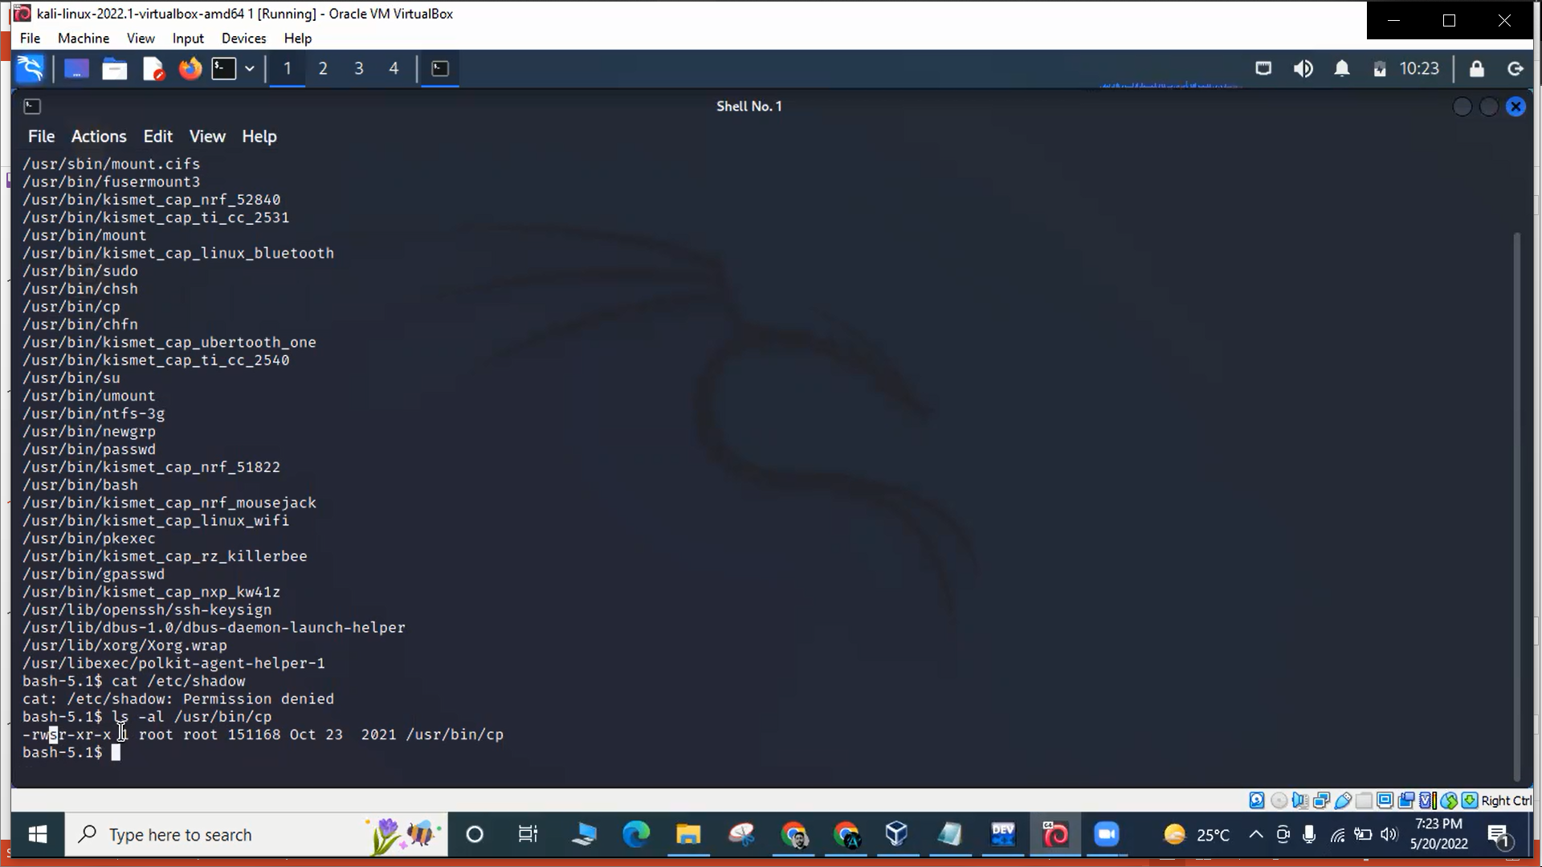
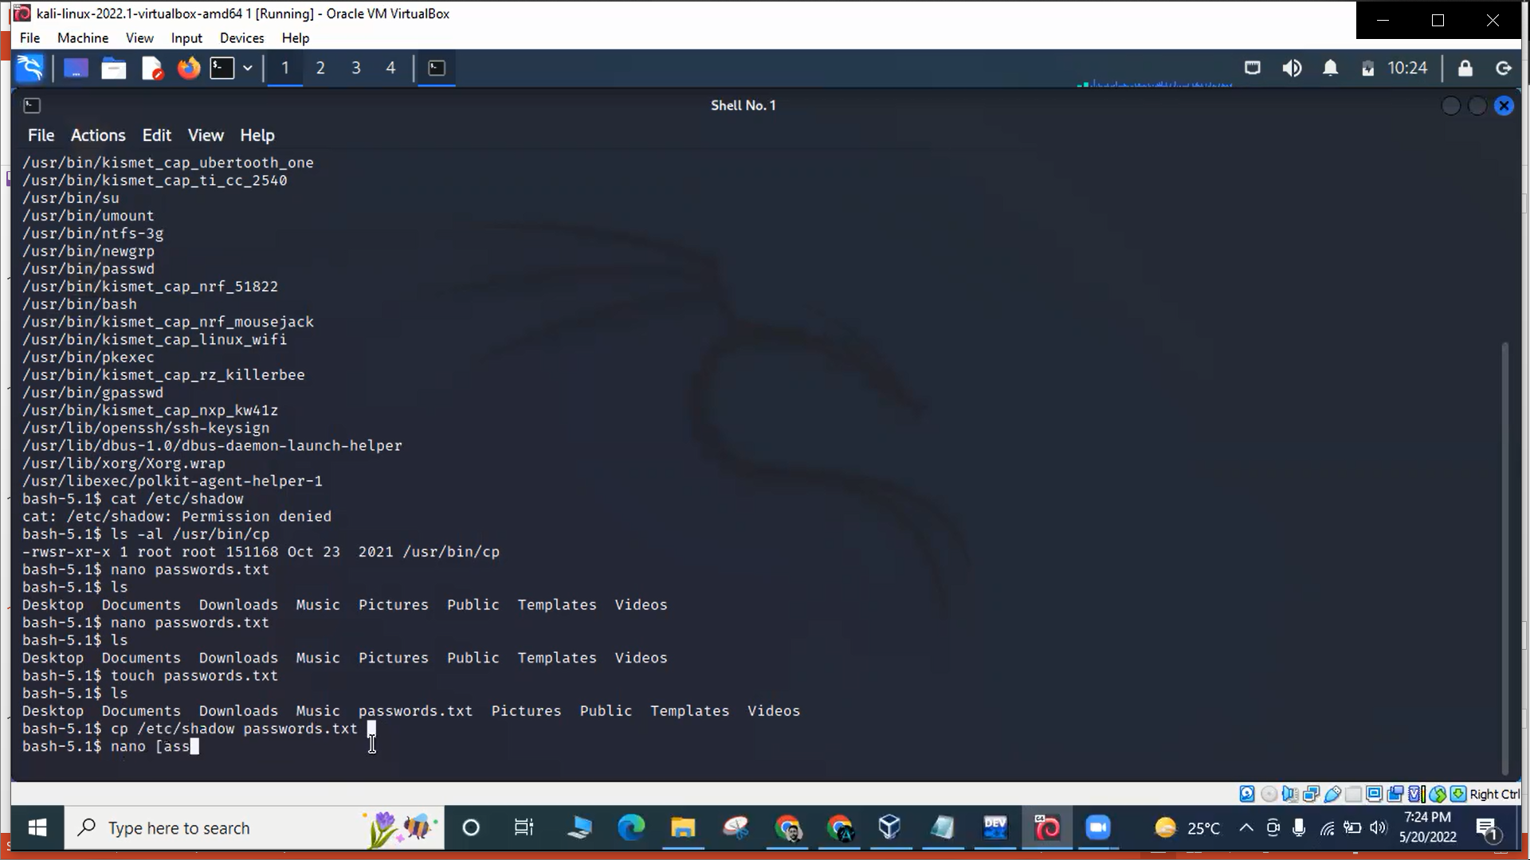
Permissions of the cp file

Slide 15
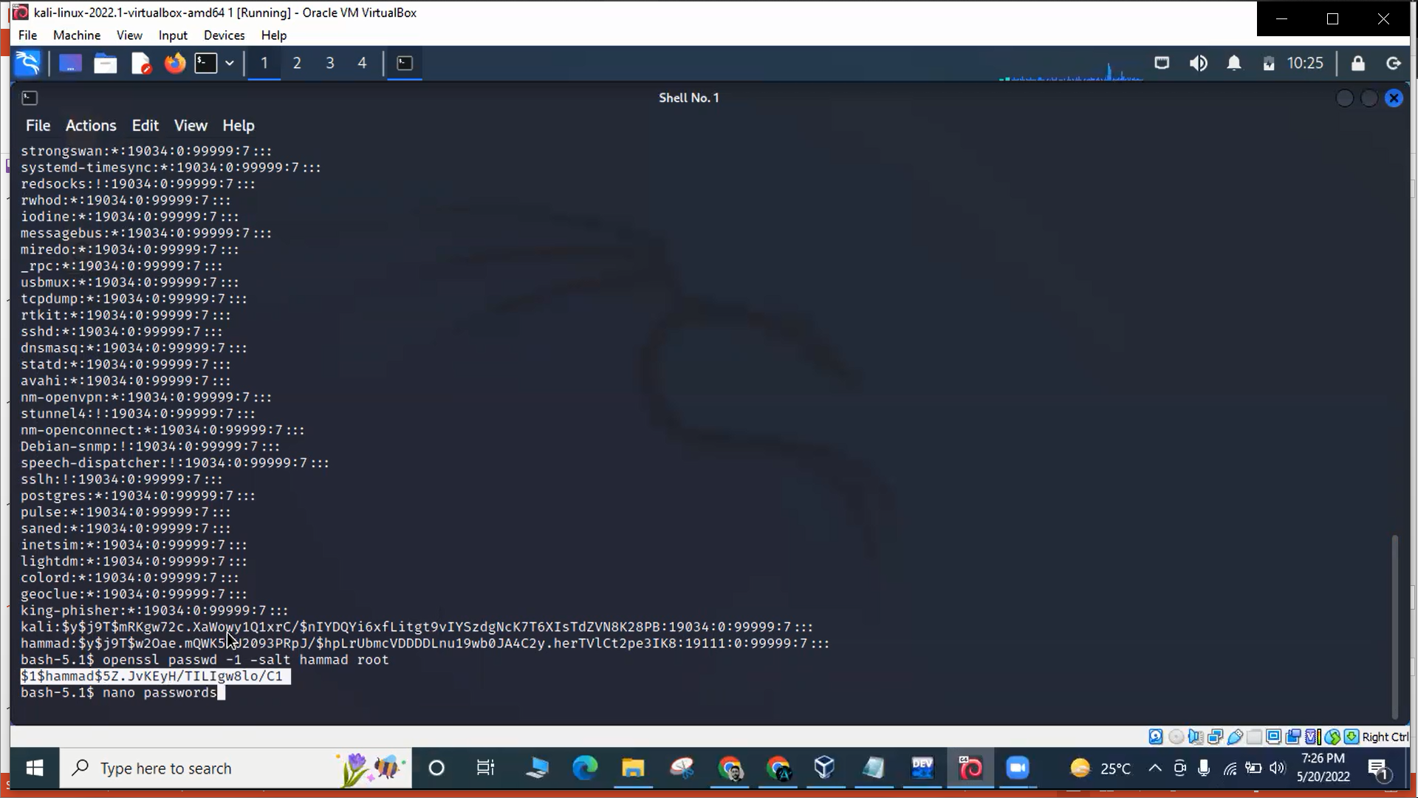
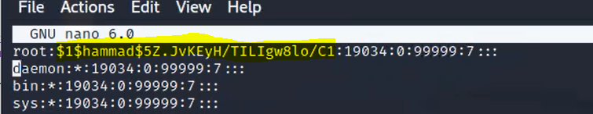




Password hashes seeing, creation and replacing

Slide 16
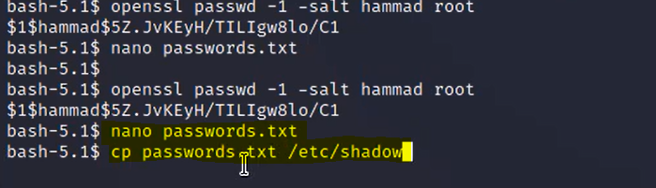
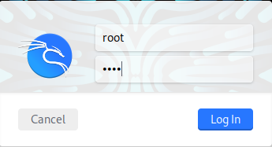
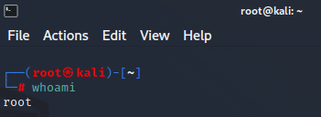



Changing the password of Root

Slide 17
CRONTABS
Another Vulnerability for escalating from kali to root
Crontab (CRON TABle) is a file which contains the schedule of entries/commands to be run and at specified times.
Cron job or cron schedule is a specific set of execution instructions specifying day, time and command to execute. crontab can have multiple execution statements.

Slide 18
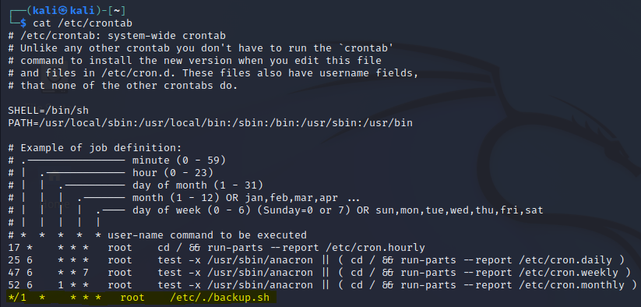
Checking system-wide crontabs.
Suspicious cronjob

Slide 19
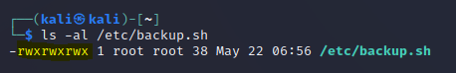
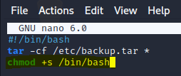
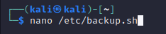
Checking permissions
Everyone can read, write and execute
Adding malicious command
Adding suid on /bin/bash

Slide 20
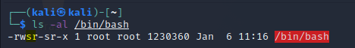
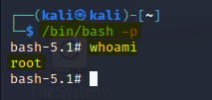
Waiting for execution
Suid is set. (worst case scenario: wait for 1 minute)
Escalating privileges

Slide 21
THANK YOU

